Slide 1

Activity-4 (Social media website)
Selecting a Theme:
  Browse through WordPress themes to find one suitable for a social media website.
  Look for themes that offer social media integration, customizable profiles, activity feeds, and other relevant features.
  Purchase or download a theme that fits your requirements.
Installing and Activating the Theme:
  Log in to your WordPress dashboard.
  Go to "Appearance" > "Themes."
  Click on the "Add New" button.
  Upload the theme file you downloaded or search for it in the WordPress theme repository.
  Once uploaded, click on the "Install" button, and then "Activate" to activate the theme.
Customizing the Theme:
  Navigate to "Appearance" > "Customize" to access the theme customization options.
  Customize the site title, logo, colors, fonts, and other visual elements to align with your brand identity.
  Configure theme-specific settings related to social media integration, user profiles, and activity feeds as per your requirements.
Adding Functionality with Plugins:
  Explore and install WordPress plugins to add additional features and functionalities to your social media website.
  Look for plugins that enhance user engagement, such as social sharing, user registration, messaging, and community forums.

Slide 2
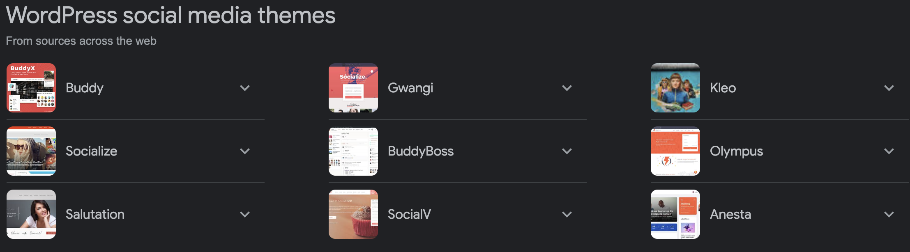
Examples of Social media themes are listed below

